Slide 1
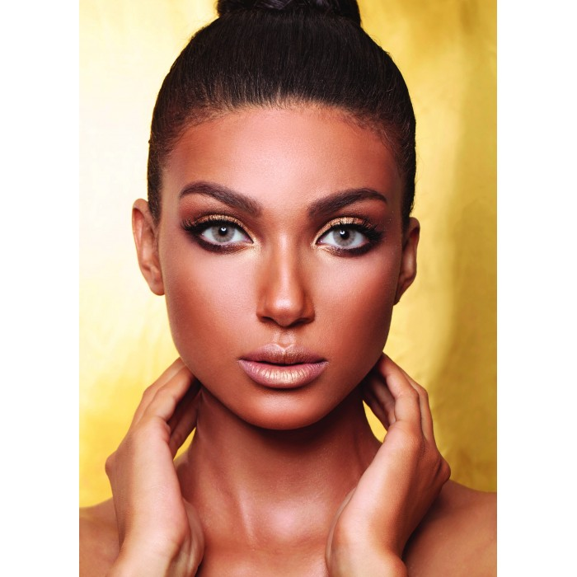
Anastasia
Anastasia Colored Lenses Adekt Amarillo (28)
SAR 150.00. Q

Slide 2
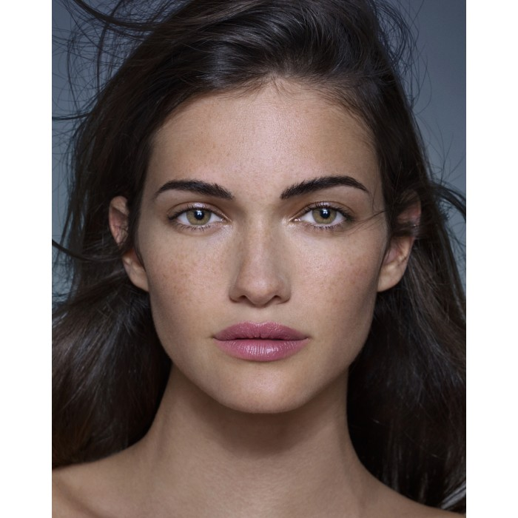
Anastasia
Anastasia Colored Lenses Adekt Arena (38)
SAR 150.00. Q

Slide 3
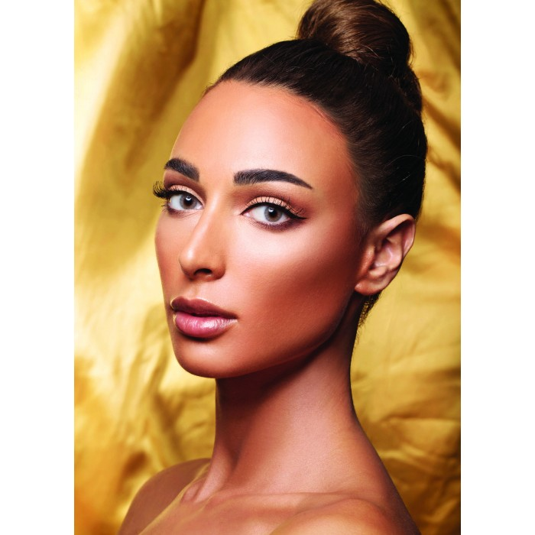
Anastasia
Anastasia Colored Lenses Adekt Azure (27)
SAR 150.00. Q

Slide 4
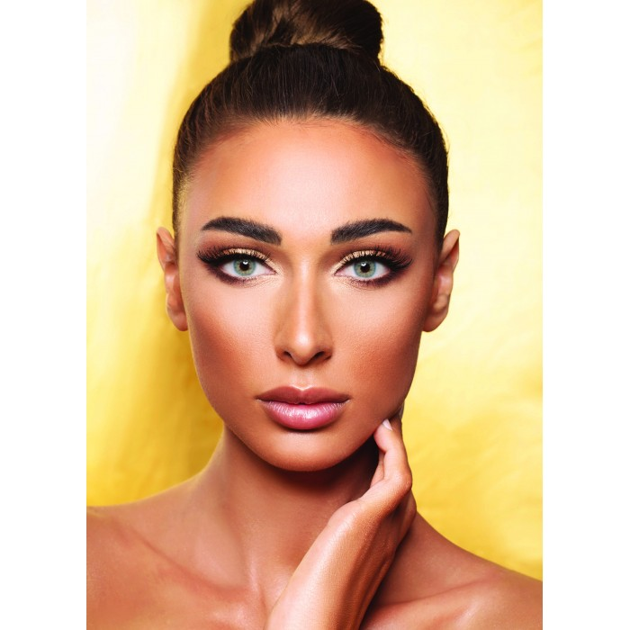
Anastasia
Anastasia Colored Lenses Adict Blue (30)
SAR 150.00. Q

Slide 5
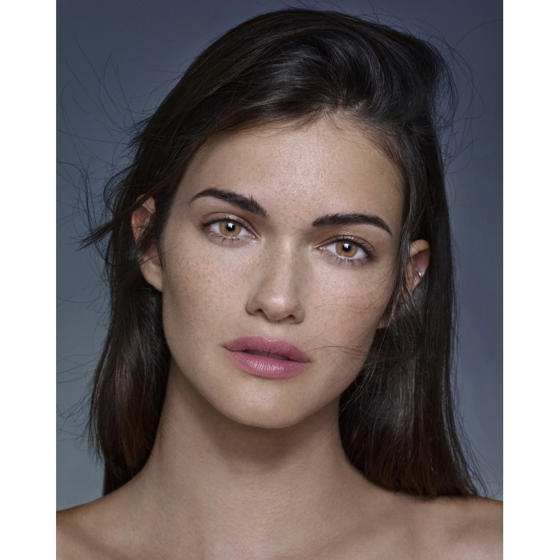
Anastasia
Anastasia Lenses of Malone act of Castano (39)
150.00 Q.S.

Slide 6
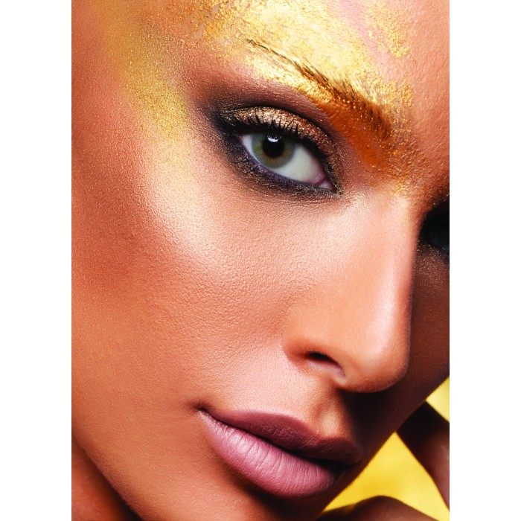
Anastasia
Anastasia Colored Lenses Adict Grey Color (25)
SAR 150.00. Q

Slide 7
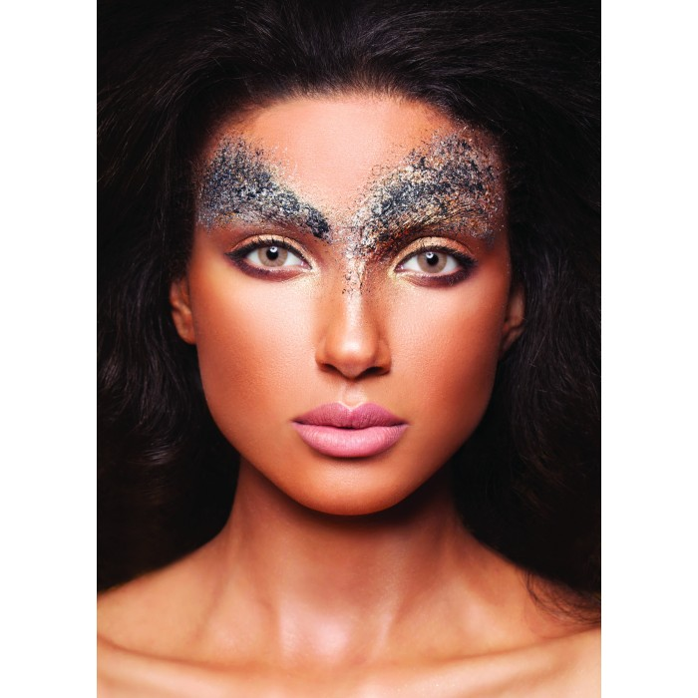
Anastasia
Anastasia Colored Lenses Adekt Oro (29)
SAR 150.00. Q

Slide 8
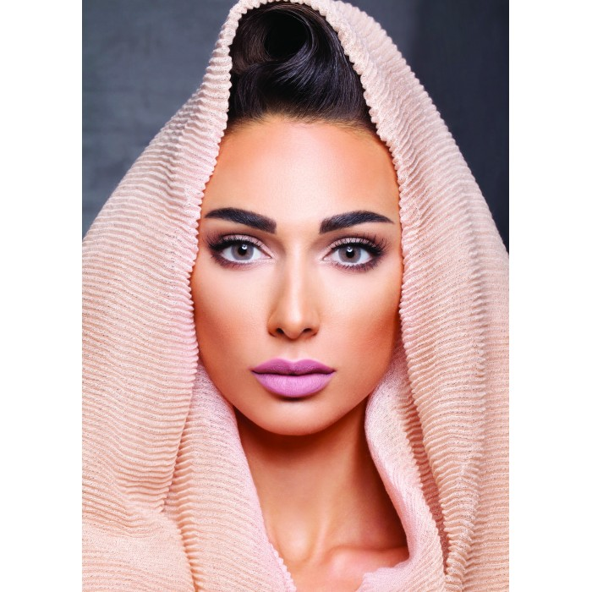
Anastasia
InstaLenses of Color Chicago Apricot (15)
SAR 150.00. Q

Slide 9
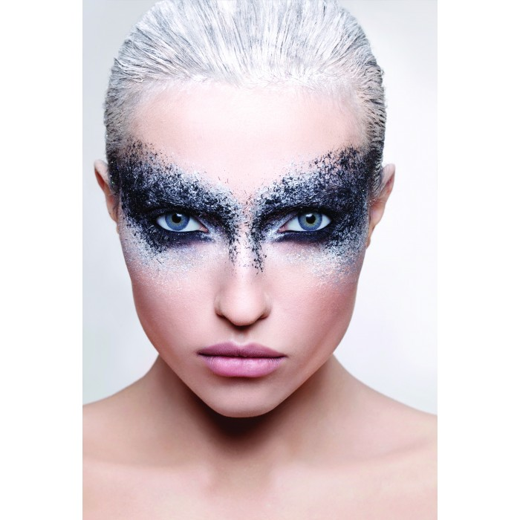
Anastasia
Anastasia Colored Lenses Blue Classic Dream (8)
SAR 150.00. Q

Slide 10
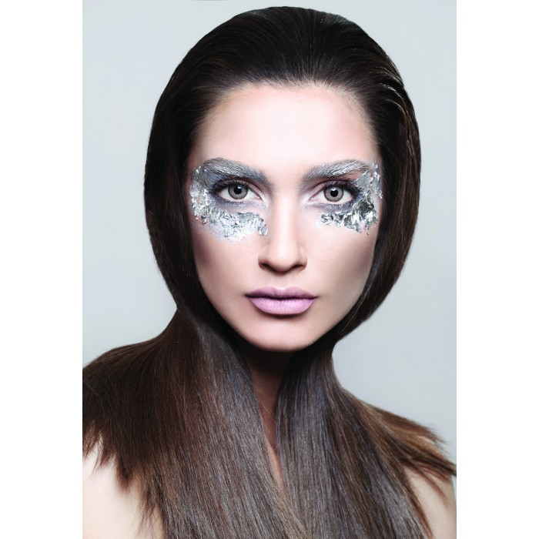
Anastasia
Anastasia Lenses Color Bronze Classic (4)
SAR 150.00. Q

